Slide 1

JQuery
Rajeev Gupta
Rgupta.mtech@gmail.com
Java Trainer & Consultant

Slide 2
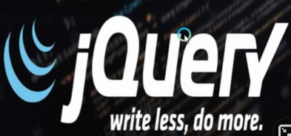
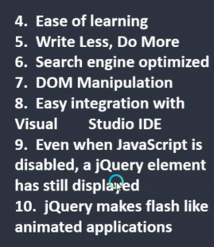
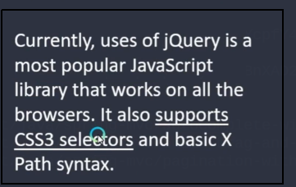
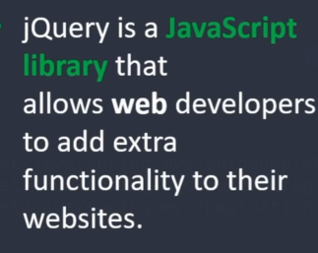
JQuery

Slide 3

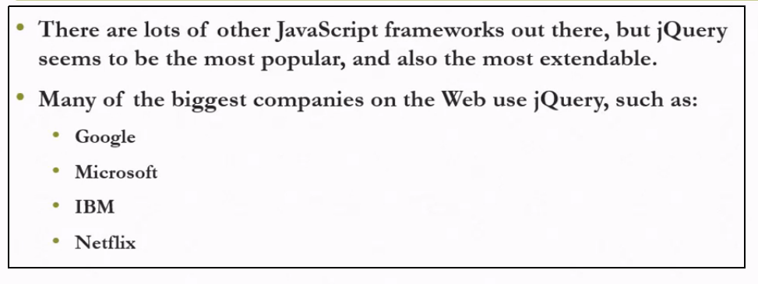
What is jQuery?

Slide 4
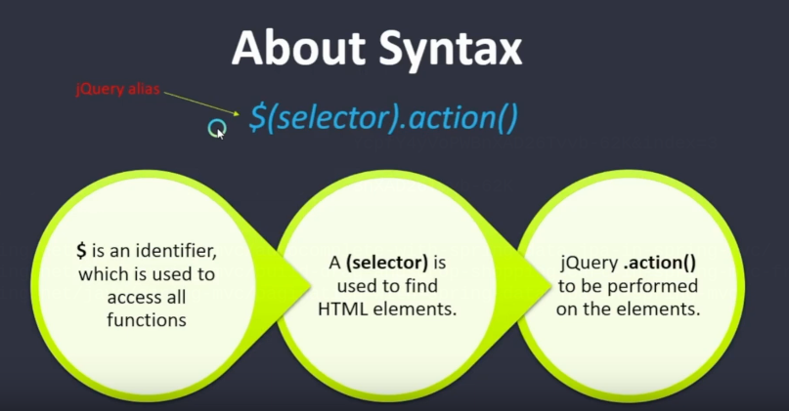
jQuery syntax

Slide 5
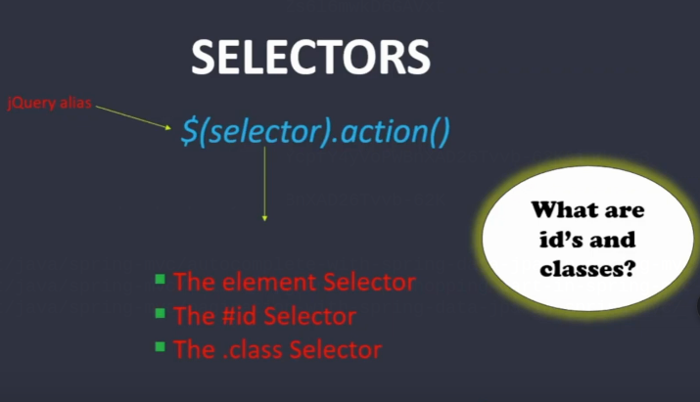
jQuery selectors

Slide 6
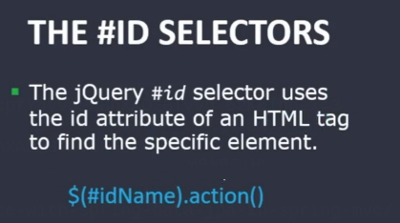
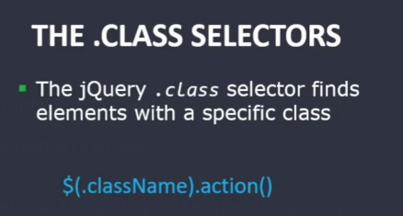
jQuery selectors

Slide 7
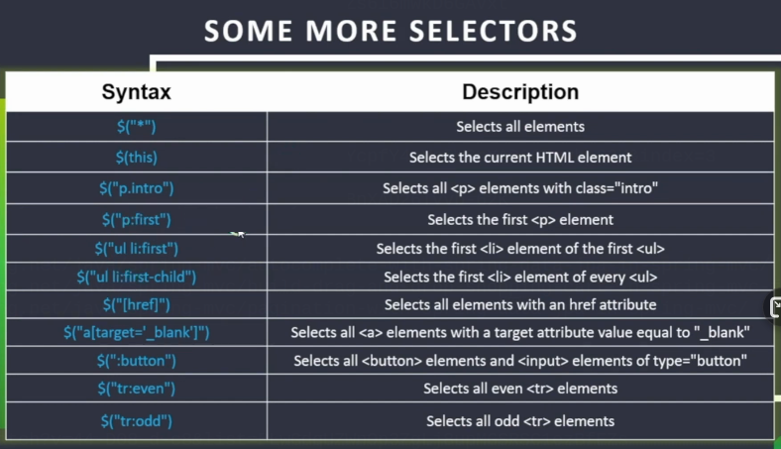
Some selectors

Slide 8

Will jQuery work with all browers?

Slide 9

Common dom events

Slide 10
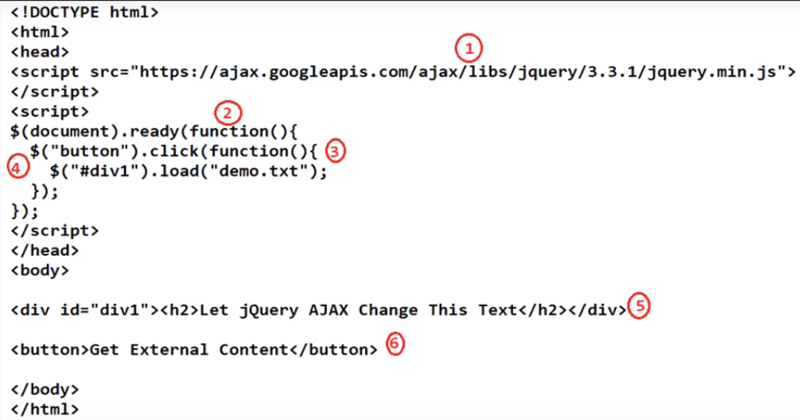

Slide 11
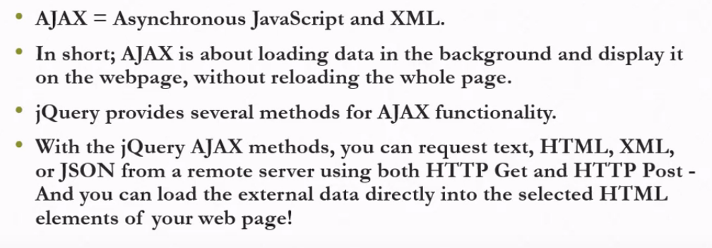
Ajax with jQuery

Slide 12
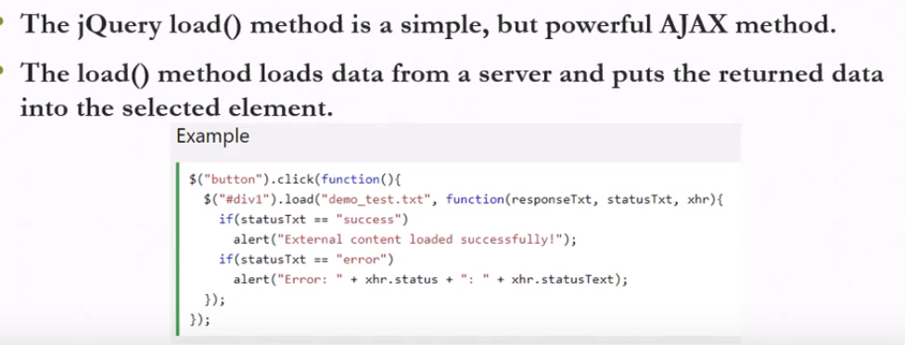
jQuery load method

Slide 13

jQuery get and post method

Slide 14
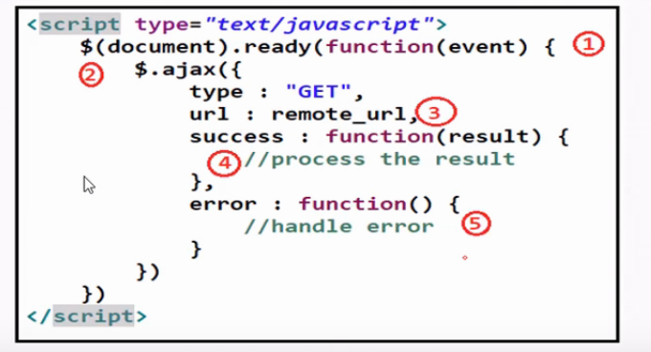
Ajax with jQuery

